Slide 1
Get what you need for your classroom through DonorsChoose.org
Notes:
Hey there! Raise your hand if you have ever spent money out of your pocket to buy something for your classroom. (wait for response) That’s a lot of money out the window!! My name is {{TEACHER NAME}} and I am a {{GRADE}} teacher from {{STATE}} and I am here to let you in on a little known teacher’s secret weapon—DonorsChoose.org. Let’s jump right in so you can hit the ground running to use DonorsChoose.org!

Slide 2
Agenda
About DonorsChoose.org
How to Get Started
Tips for Success
My Story
Try It Out

Slide 3
What is DonorsChoose.org?
Notes:
What is DonorsChoose? DonorsChoose.org is a national nonprofit that helps connect citizen donors to classroom teachers in order to equip their students with the resources and experiences they need for a great education. They work with a huge network of citizen donors, corporations and philanthropists to bring your classroom dreams to life. Their ultimate goal is to help teachers stop paying out of pocket, a mission we can all seriously get behind.

Slide 4
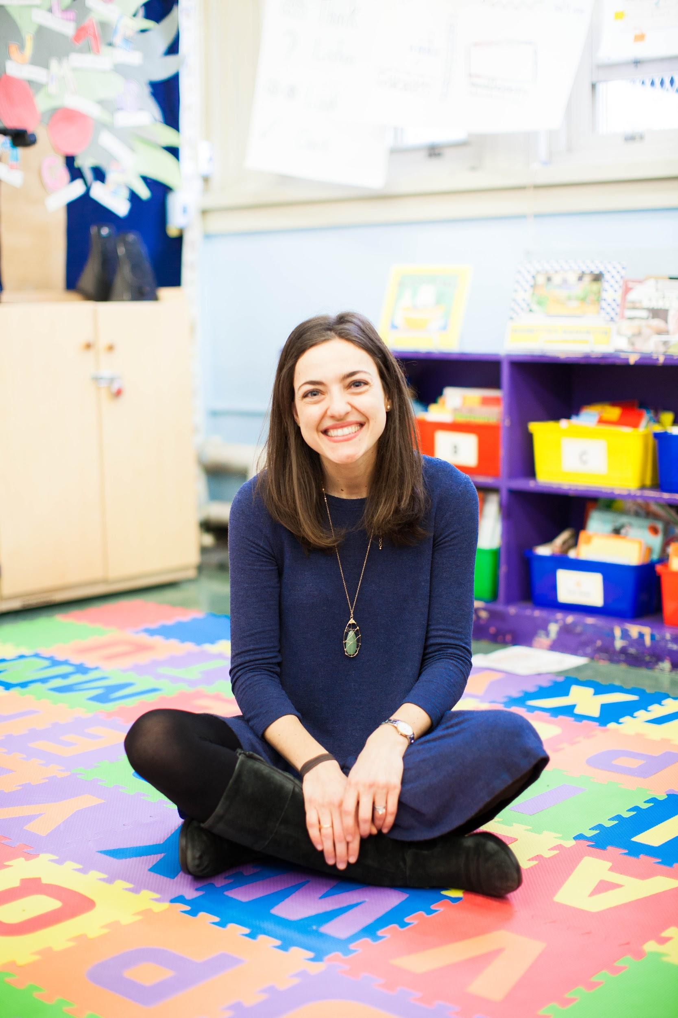
Teachers ask.
“My students need a projector for the classroom.” —Mrs. Aheart, elementary teacher
Notes:
Basically, you create a classroom wish list by shopping at our reputable vendors like Amazon, Best Buy, Lakeshore, School specialty or Staples. You write a short description of your students, what resources you need and how they will be used.

Slide 5
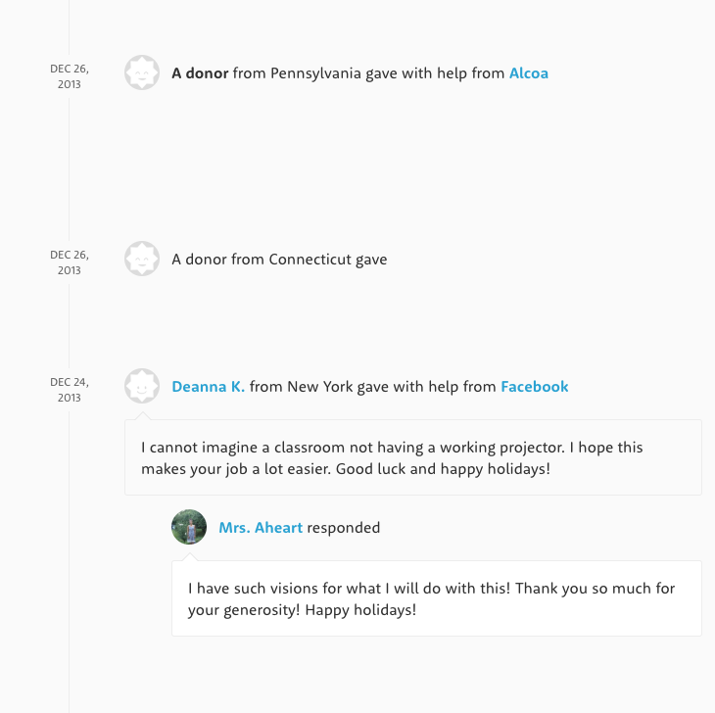
Donors choose.
“I gave to this project because I want to support the children of Willimantic. I hope they love their new projector.” —A donor from Connecticut
Notes:
Your project then goes live on our site. We activate our network of donors, while you share the project out with your network.

Slide 6
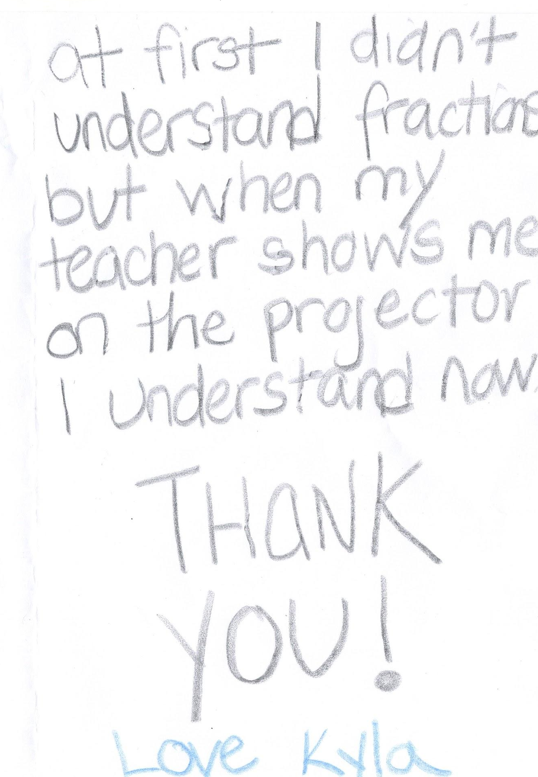
Students learn.
“At first I didn’t understand fractions but when my teacher shows me on the projector I understand now. Thank you!” —Kayla, student
Notes:
Once the project is funded we purchase the materials and ship them straight to you. Finally, no fundraising slips, money collection or long grant writing process. That’s a LOT of happy teachers and students.

Slide 7
DonorsChoose.org is the nonprofit classroom funding site for teachers
It’s easy for teachers to get the exact materials they need.
There’s a strong community of donors and partners who are eager to fund projects, even from teachers they don’t know.
It’s built exclusively for educators to help them succeed in the classroom.
Notes:
Give a holler if you have used DonorsChoose.org. (wait for response) wow, that is a ton of teachers! Teachers love DonorsChoose.org because it’s an easy way for them to get what they need without paying out of pocket. It was built by teachers, with teachers, for teachers and is one of the only places where lovers of public education are literally waiting to support classroom projects. Most projects on DonorsChoose.org get a donation from a complete stranger-someone who believes in you and your students. It’s like a surprise highfive on a busy day.

Slide 8
Our Impact
$700,000,000 Dollars raised for classrooms
1,100,000 Projects funded
400,000 Teachers supported
Notes:
DonorsChoose has been around for 17 years and has had a huge impact on classrooms across the nation. The DonorsChoose community has raised over 600 million dollars, funding almost a million projects. 77% of all the public schools in America have at least one teacher who has posted a project on DonorsChoose.org. In my classroom alone, we’ve gotten {{ADD AN EXAMPLE FROM YOUR CLASSROOM HERE}}.

Slide 9
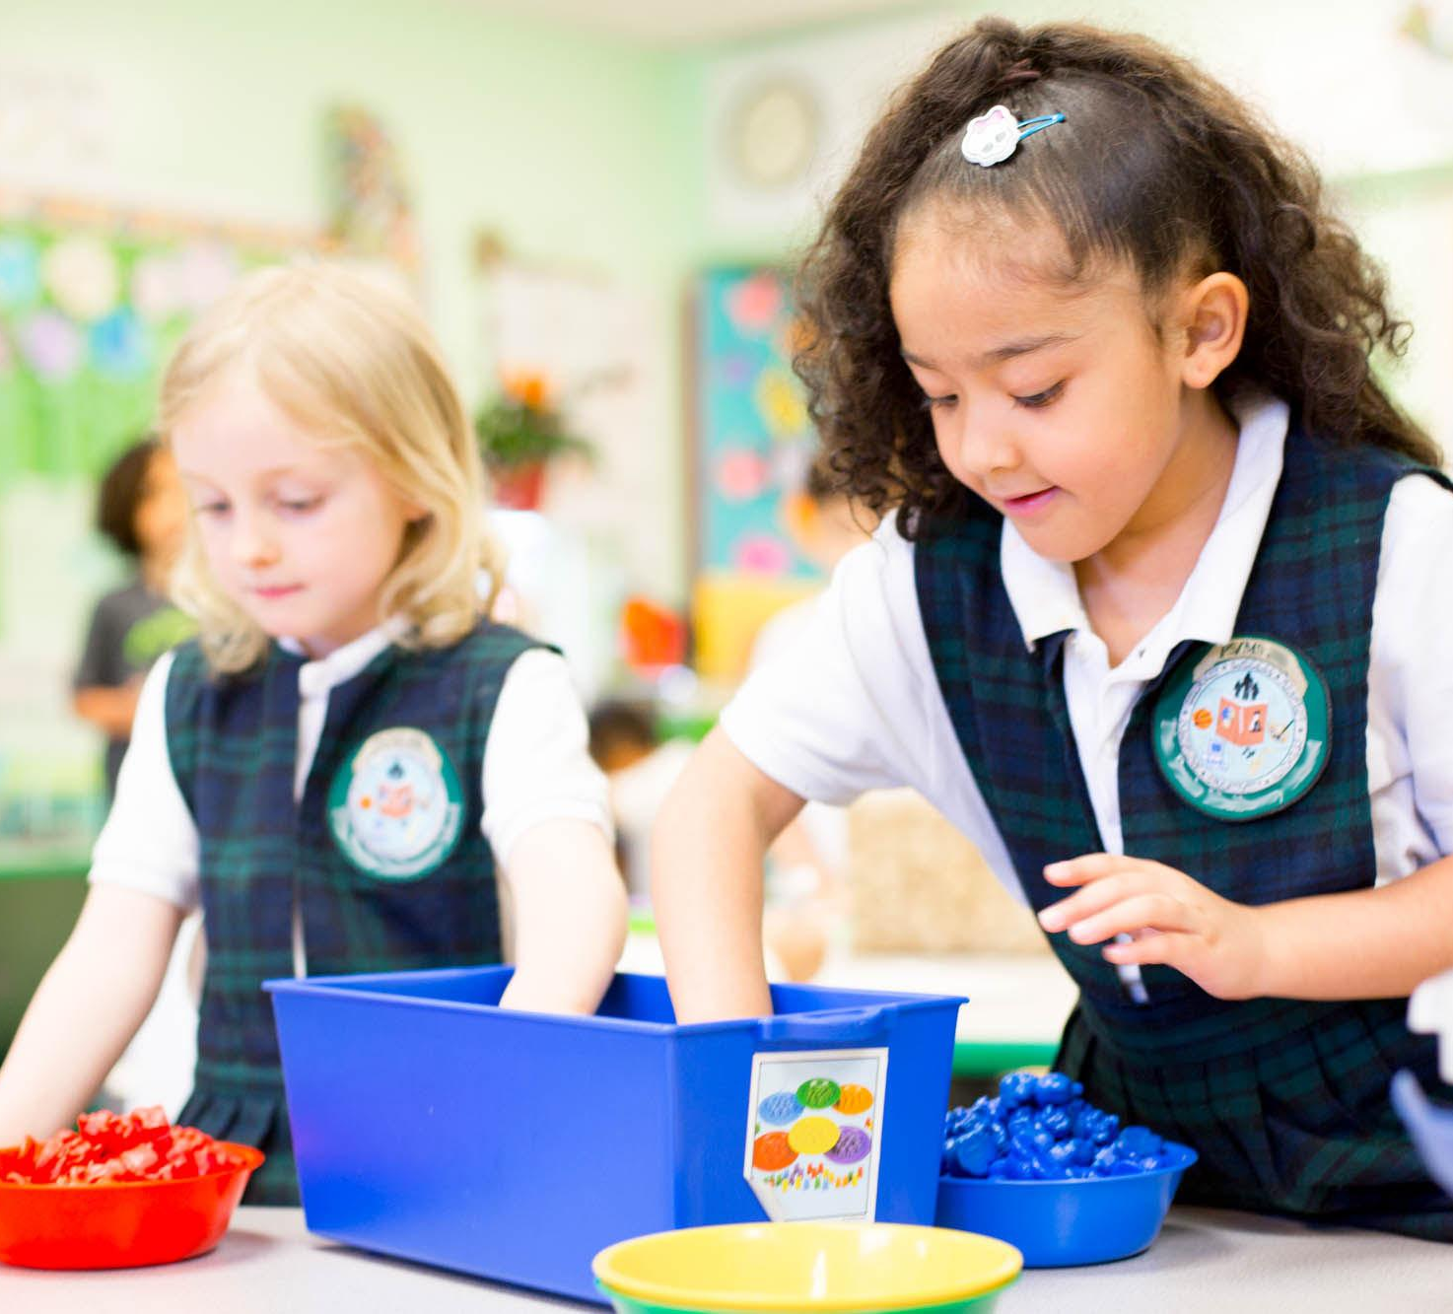
How to Get Started
Notes:
Ready to tap into that funding? Getting started on DonorsChoose.org is super easy. First, you go online shopping through the platform at awesome vendors-some of the most popular are Amazon, Lakeshore, Staples and School Specialty. Then, you write a short essay explaining who you students are, how they will use the materials and how this will bring their learning to the next level. Once the project is approved by a team of teacher volunteers, it gets posted on the site and you can start your fundraising. This process might sound long, but I promise it is short and easy, so I’ll break it down for you.

Slide 10
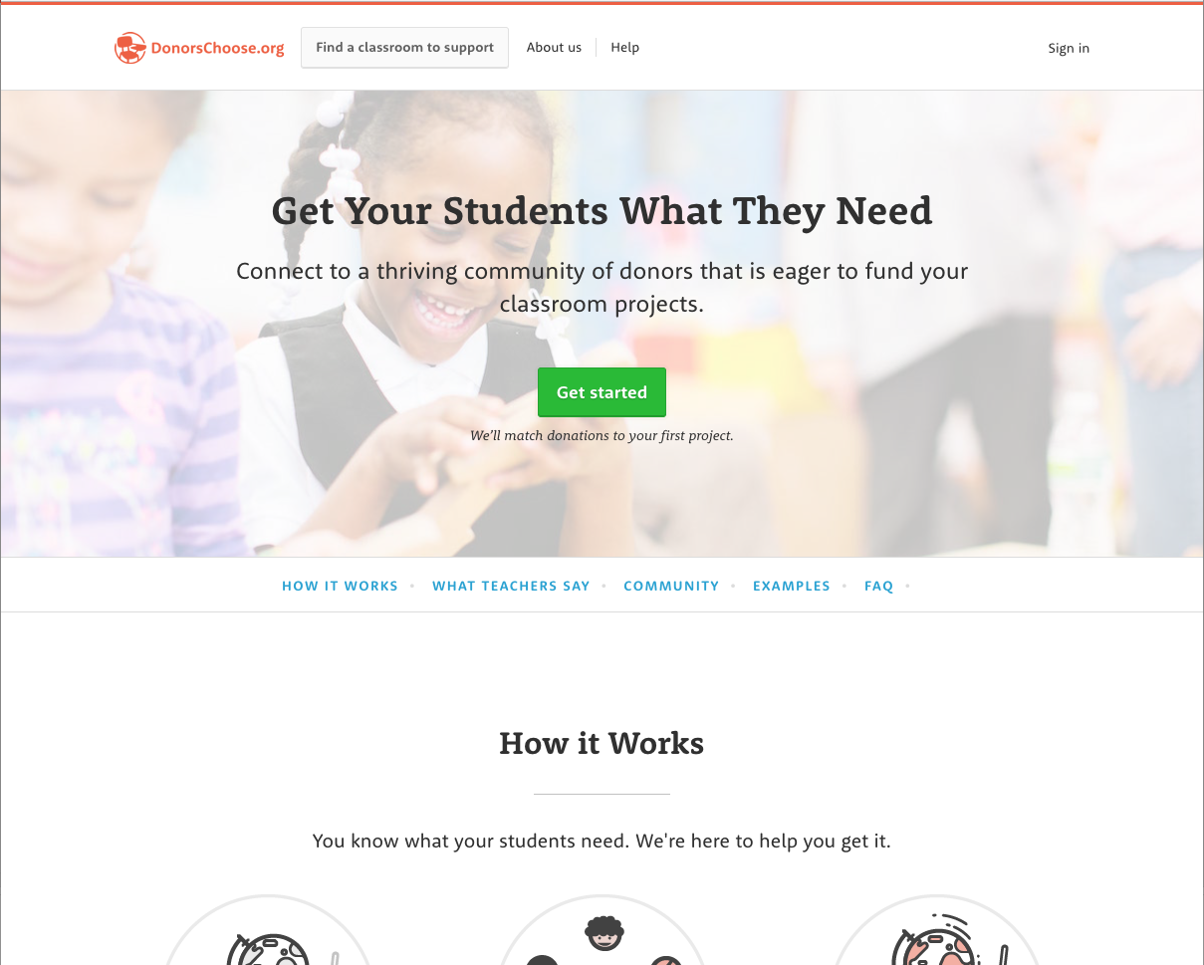
Create an Account
Click “Get started”
Notes:
Start by creating an account on DonorsChoose.org. It’s easy and free-it takes most people only about 5 minutes. Once you confirm your email you are set to start accessing that classroom funding.

Slide 11
Brainstorm what your classroom needs
Finish these sentences
To teach an upcoming unit, my students need_______.
To bring my dream learning activity to life, my classroom needs _______.
To make my school a more vibrant and engaging place for students, my school needs _______.

Slide 12
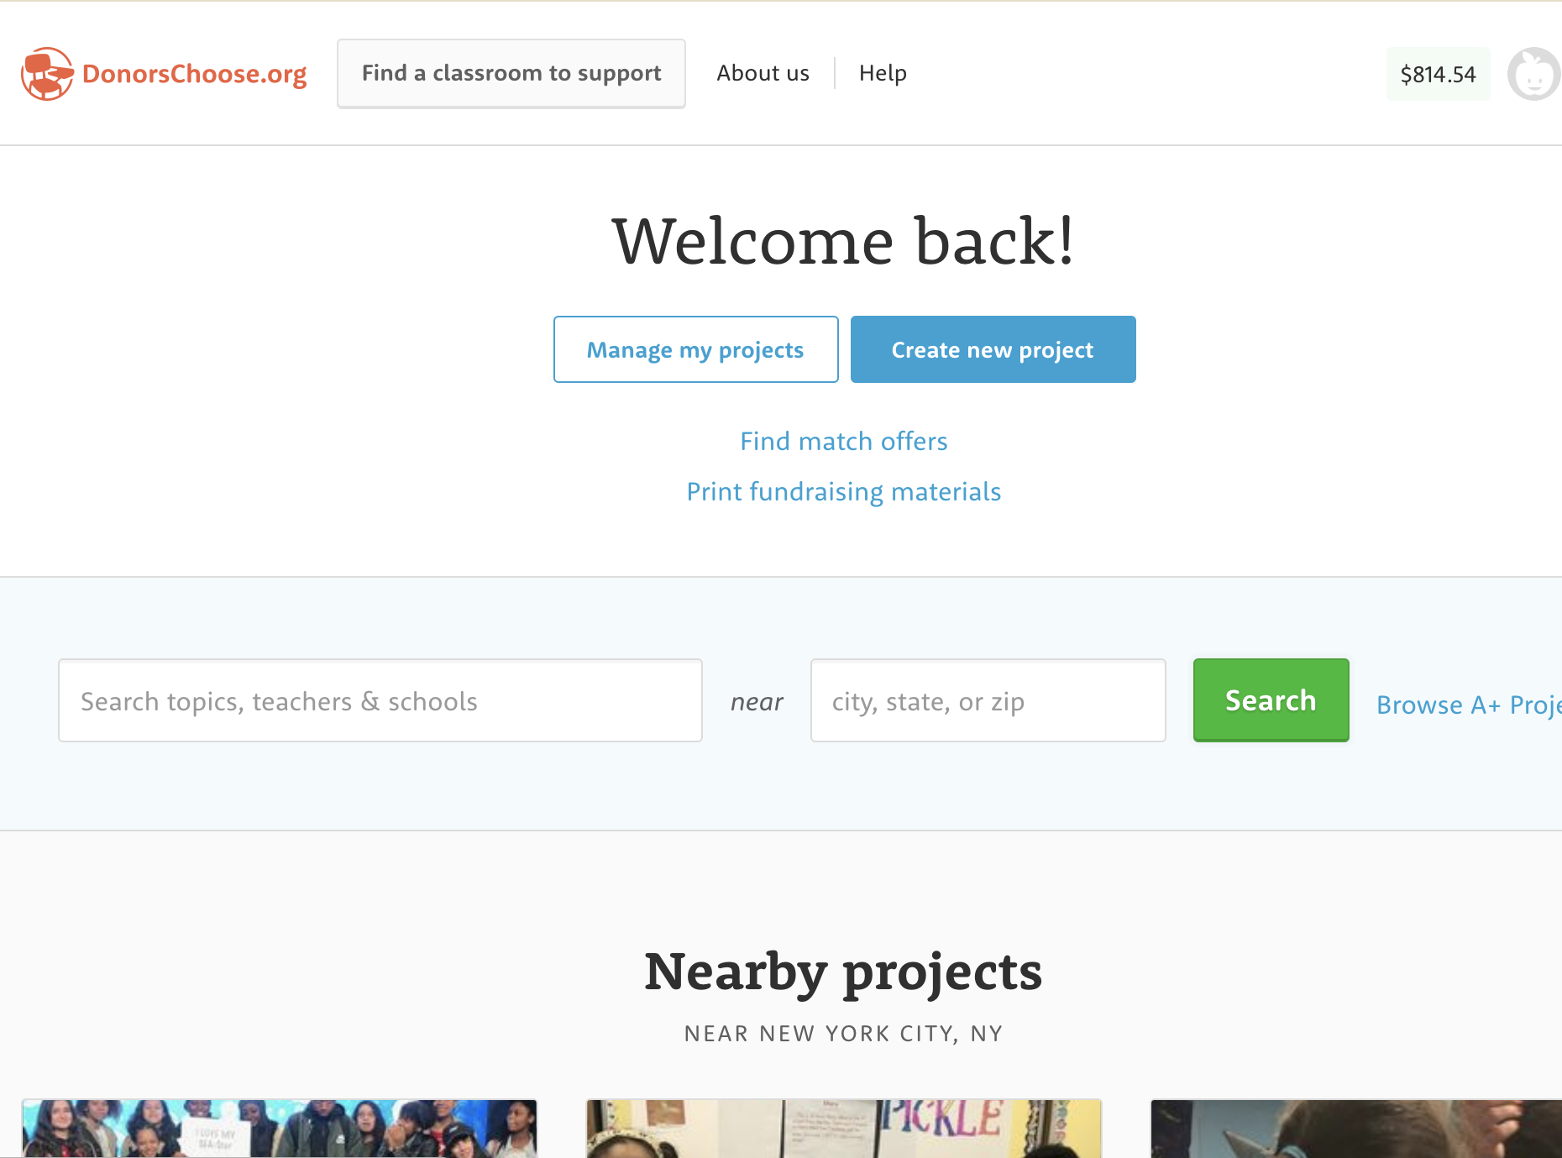
Create
a Classroom Project Request
Once you log in to your account, click ‘create a project’
Notes:
Start by creating an account on DonorsChoose.org. It’s easy and free-it takes most people only about 5 minutes. Once you confirm your email you are set to start accessing that classroom funding.

Slide 13
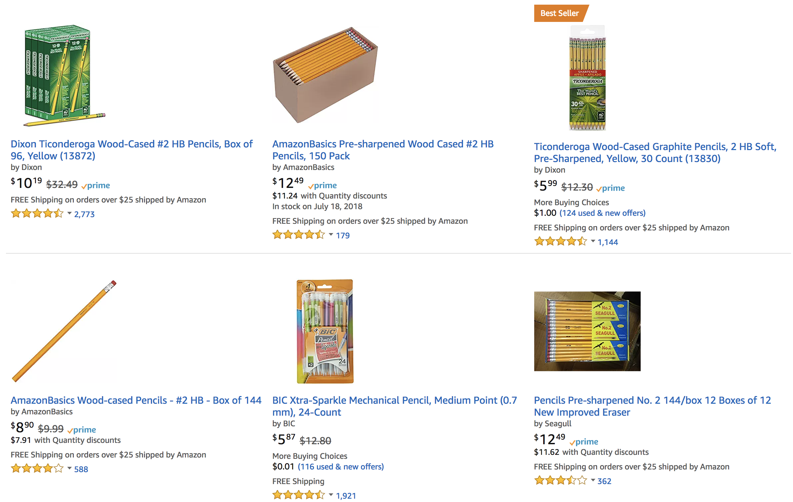
Shop for what you need through our vendor portal
Notes:
Now you have a project idea, so it is time to get to work. Is it wobble stools, chromebooks or new classroom library books? Once you have an idea, the shopping process is super easy. It feels just like online shopping-you find what you need and you put it in your cart. You will be directed to a list of vendors that DonorsChoose.org partners with. Some teacher favorites are Lakeshore, Amazon, Best Buy, Staples and School Specialty. A great pro-tip is to comparison shop, just like you would for any other purchase.

Slide 14
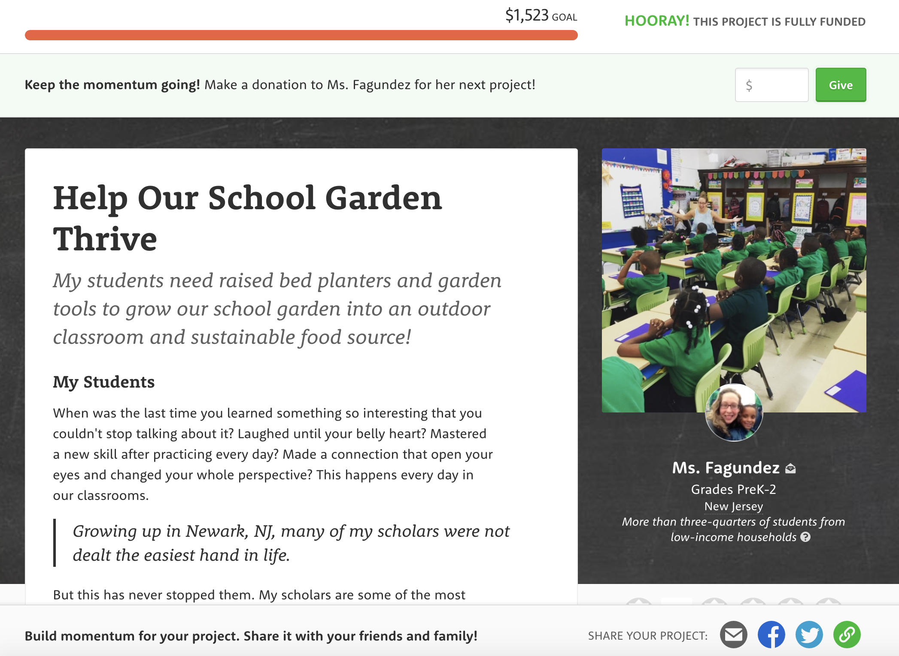
Tell donors
a bit about your students and project
Notes:
That cart gets pushed on to DonorsChoose and you start your first project! You might have heard me use the word project-that’s just what DonorsChoose calls your classroom request. Here is a good example-Ms. Fagundez from Newark, NJ is asking for materials to help her classroom start a school garden. She’s shopped for her items (soil, garden tools and planters) listed what they need, and goes on to tell potential donors about her students. Now, let’s get to the fun part!

Slide 15
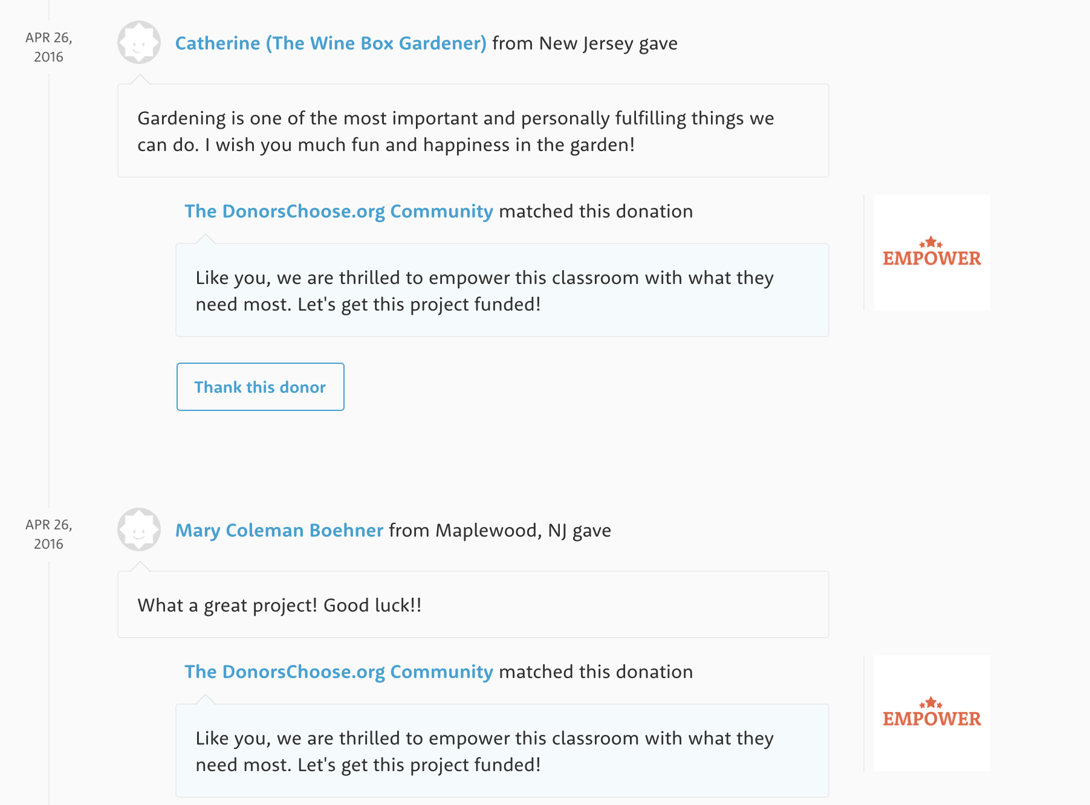
Donations to your first project will be matched!
Notes:
Donors who believe in education, believe in Ms. Fagundez or just love gardening add their support to her project. DonorsChoose.org, or other organizations across the country, match that donation. A special thing they do is that every donation up to $50 on your first project is matched for the first week. The more you share within your network, the more donations you get.

Slide 16
Share code LIFTOFF to match donations.
Eligible the first week of your first project
Matches donations up to $50
Donors enter code when they make their donation
Share your project in your network
Email
Social Media
Notes:
One part that teachers sometimes worry about is how they will get their project funded. Almost 80% of projects on the site are funded, and with these teacher tips, your chances of getting funded go up a ton. The first tip is that lower cost projects have a much higher funding rate-try to keep your first project at $600 or below. Next, check out the funding opportunities that are available. Just last month DonorsChoose.org offered funding opportunities through their partnership with the Gates Foundation, Lady Gaga’s Born This Way Foundation, Macys and General Motors. The most important step is to share your classroom project in your network. On Facebook, email, or on flyers in your community. Getting the word out is crucial! [Speaker can add additonal tip here if they would like!]

Slide 17
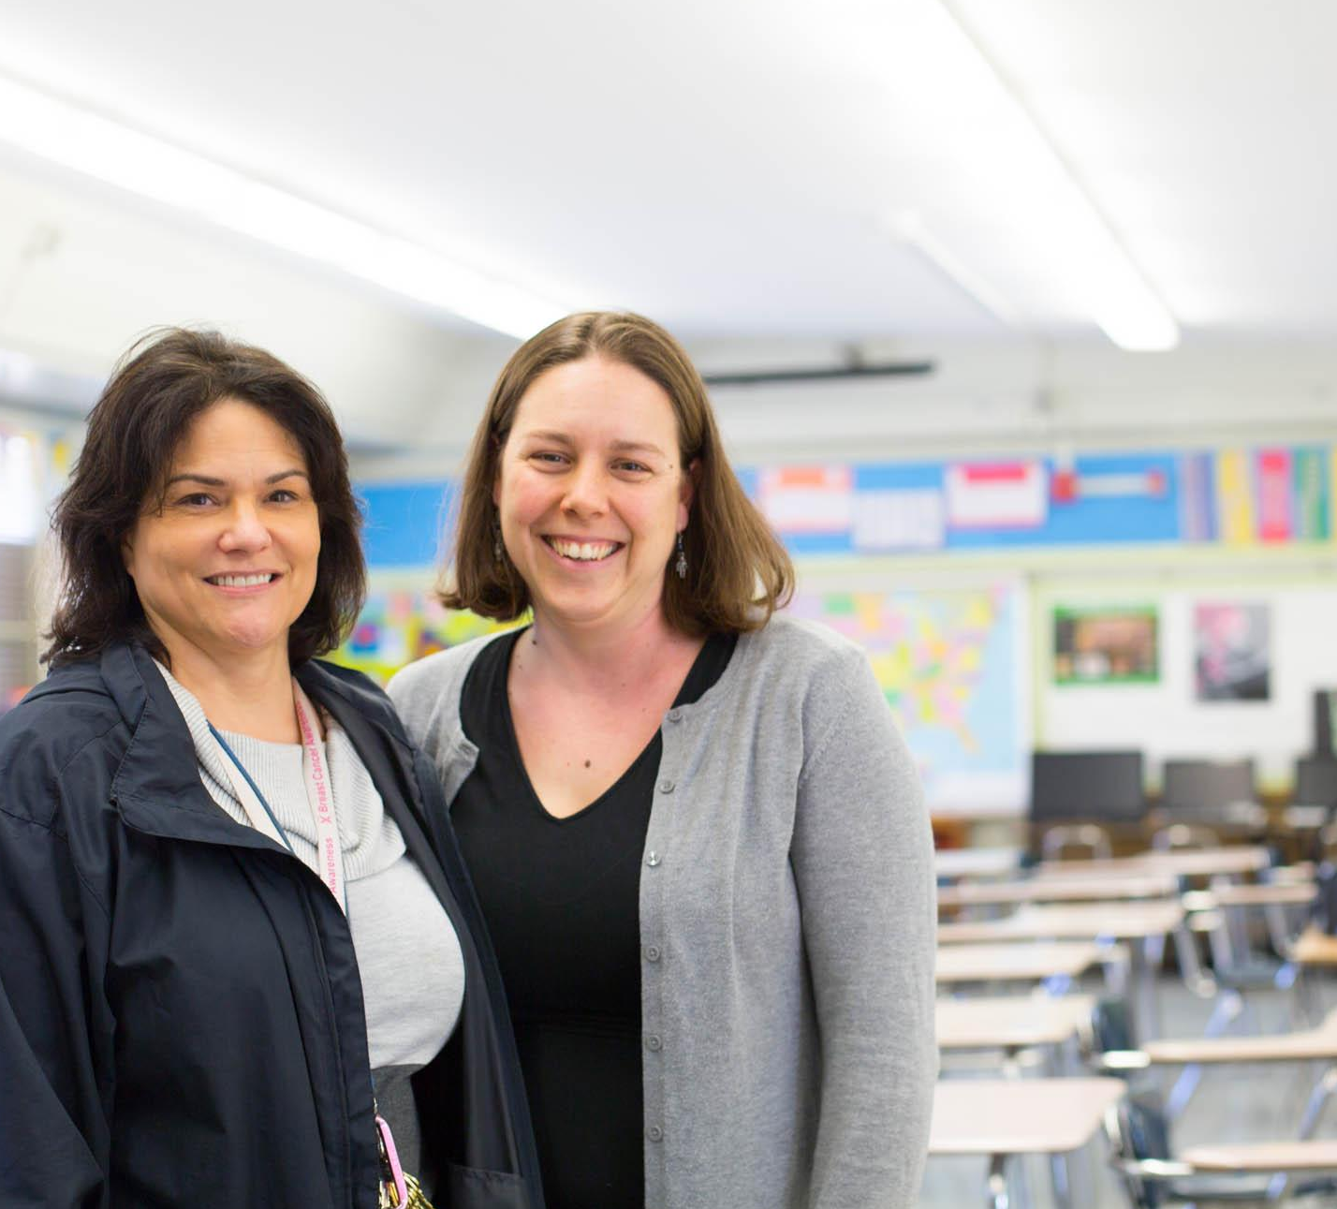
Let’s Get Started!
Go to http://share.donorschoose.org/nhVHL
Click ‘Create a New Project’
Notes:
This is a great place to add your Refer-a-Teacher link!

